Slide 1
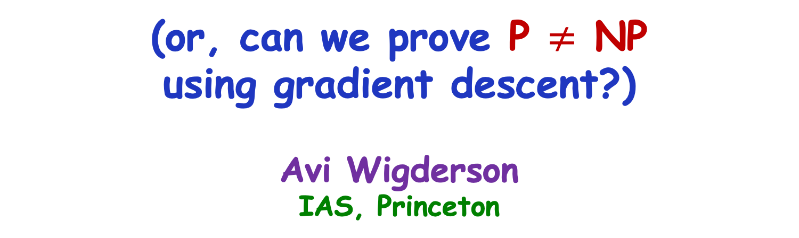
Optimization, Complexity, and Math
(or, can we prove P $≠$ NP
using gradient descent?)
Avi Wigderson
IAS, Princeton
Zeyuan Allen-Zhu, Peter Burgisser, Cole Franks, Ankit Garg, Leonid Gurvits, Pavel Hrubes, Yuanzhi Li, Visu Makam, Rafael Oliveira, Michael Walter

Slide 2
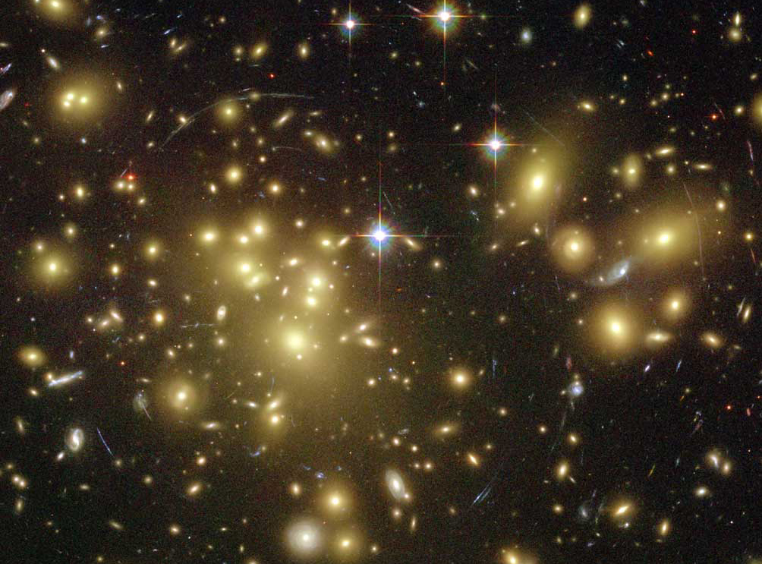
Scientific / Mathematical/ Intellectual /
Computational problems
NP: Problems we
want to solve/understand
P: Problems we can solve/understand
P=NP?
Notes:
We’ll try to put some structure in this universe.
Computational problems are often essential components of scientific, mathematical and other intellectual challenges.

Slide 3
Plan
One problem
Singularity of Symbolic Matrices
One algorithm
Alternating minimization
…internalize
…generalize (algorithms, problems, tools)
Extending convex optimization in Euclidean space to (geodesic) convex optimization on Riemannian manifolds, quantitative bounds

Slide 4
Applications & Connections
Non-commutative Algebra
Word problem in free skew fields
Invariant Theory
Nullcone membership & orbit closure intersection
Quantum Information Theory
Positive operators, quantum marginals
Analysis
Brascamp-Lieb inequalities
Operator Theory
Pauslen’s problem on Parseval frames
Statistics
MLE in Gaussian models, Tyler’s M-approximation
Computational complexity
Symbolic matrices, algebraic identities, lower bounds
Optimization
Efficiently solving certain general families of
- Quadratic systems of equations
- Exponentially large linear LPs

Slide 5
Optimization, Complexity and Math
through one problem and one algorithm
One problem
Singularity of Symbolic Matrices
One algorithm
Alternating minimization

Slide 6
The problem(s)

Slide 7






Perfect Matchings (PMs)
V
Bipartite graphs G(U,V;E).
|U|=|V|=n
1
1
1
U
V
U
V
1
0
0
U
1
0
0
G’
G
A_{G}
Fact: G has a PM iff Per(A_{G})>0 Per_{n}(A)=∑_{σ∈Sn} ∏_{i∈[n]} A_{iσ(i)}
[Jacobi‘1890] PM ∈ P (P = polynomial time)
Notes:
Jacobi’s interest was efficiently solving a system of ODEs

Slide 8
PMs & symbolic matrices [Edmonds‘67]
U
V
1
1
1
x₁₁
x₁₂
x₁₃
1
0
0
x₂₁
0
0
1
0
0
x₃₁
0
0
G
A_{G}
A_{G}(X)
[Edmonds ‘67] G has a PM iff Det(A_{G}(X)) ≠ 0 (∈ P)
Notes:
Of course, this is in PPM

Slide 9
Symbolic matrices [Edmonds‘67]
L₁₁
L₁₂
L₁₃
X = {x₁,x₂,… } F field (F=Q)
L_{ij}(X) = ax₁+bx₂+… :linear forms
L(X) = A₁x₁+A₂x₂+…+A_{m}x_{m} A_{i}∈Mat_{n}(F)
SING: Given (A₁,… A_{m}) is Det(L(X))=0?
[Edmonds ‘67] SING ∈ P ??
[Lovasz ‘79] SING ∈ RP
[Valiant ‘79] SING captures algebraic identities (PIT)
Math special cases: Module isomorphism, graph rigidity,…
[Kabanets-Impagliazzo‘01] SING ∈ P ➔ “P ≠ NP”
Derandomization, Lower bounds
L₂₁
L₂₂
L₂₃
L₃₁
L₃₂
L₃₃
Randomized
Poly Time
L(X)
Notes:
We will explain the quotation marks presently

Slide 10
Symbolic matrices dual life
X = {x₁,x₂,… x_{m}} F field
L(X) = A₁x₁+A₂x₂+…+A_{m}x_{m}
Input: A₁,A₂,…,A_{m} ∈ M_{n}(F)
SING : Is L(X) singular?
x_{i} commute
in F(x₁,x₂,…,x_{m})
[Lovasz ’79] SING ∈ RP
[Edmonds’67] SING ∈ P?
L₁₁
L₁₂
L₁₃
L₂₁
L₂₂
L₂₃
L₃₁
L₃₂
L₃₃
x_{i} do not commute
in F<(x₁,x₂,…,x_{m})> (free skew field)
[Cohn’75] NC-SING Decidable
[CR’99] NC-SING ∈ EXP
[GGOW’15] NC-SING ∈ P (F=Q)
[IQS’16] NC-SING∈ P (F large)
Notes:
The problem we will really solve, and whose algorithms inspired the work underlying this workshop

Slide 11
The algorithm
Alternate minimization

Slide 12
Perfect Matchings (PMs)
V
Bipartite graphs G(U,V;E).
|U|=|V|=n
1
1
1
U
V
U
V
1
0
0
U
1
0
0
G’
G
A_{G}
Fact: G has a PM iff Per(A_{G})>0 Per_{n}(A)=∑_{σ∈Sn} ∏_{i∈[n]} A_{iσ(i)}
[Jacobi‘1890] PM ∈ P (P = polynomial time)
Notes:
Jacobi’s interest was efficiently solving a system of ODEs

Slide 13
Matrix Scaling
[…Sinkhorn’64,…]
A non-negative matrix.
A doubly-stochastic (DS): A1=1, A^{t}1=1
Scaling:
Multiply rows & columns by scalars
DS-Scaling:
Find (if exists?) R,C diagonal s.t.
RAC has row-sums & col-sums ≈ 1
Why?
Numerical analysis
Signal processing
Approx Permanent
Perfect matching
……
A
R
A
C
⬅➔ Per(A)>0
Notes:
A completely new interpretation of perfect matching
Matrix scaling is a whole field by itself !
Diagonal matrices forma group, D_n! Scaling lives in the orbit of A under D_n x D_n
This new equivalent description of PM will lead to a completely new algorithm for it.

Slide 14
Scaling algorithm [Sinkhorn’64,…]
A non-negative matrix. Try making it doubly stochastic.
(e.g. the adjacency matrix A=A_{G} of a bipartite graph G)
Find (if exists?) R,C diagonal s.t.
RAC has row-sums & col-sums ≈1
Hard to do simultaneously…
Let’s deal with rows & cols separately!
1
1
1
1
0
0
1
0
0

Slide 15
Scaling algorithm [Sinkhorn’64]
1/3
1/3
1/3
Scale rows
1
0
0
1
0
0

Slide 16
Scaling algorithm
1/7
1
1
Scale columns
3/7
0
0
3/7
0
0

Slide 17
Scaling algorithm
1/15
7/15
7/15
Scale rows
1
0
0
1
0
0

Slide 18
Scaling algorithm
0
1
1
Scale columns
1/2
0
0
1/2
0
0

Slide 19
Scaling algorithm
0
1/2
1/2
Scale rows
1
0
0
1
0
0

Slide 20
Scaling algorithm
0
1
1
Scale columns
1/2
0
0
1/2
0
0

Slide 21
Scaling algorithm
0
1/2
1/2
Scale rows
1
0
0
1
0
0
No convergence!
No perfect matching: Per(A)=0

Slide 22
Scaling algorithm
A non-negative matrix. Try making it doubly stochastic.
Scaling factors
R(A) = diag(row sums)⁻¹ C(A) = diag(column sums)⁻¹
Repeat n³ times:
Scale rows A $←$ R(A)×A
Scale cols A $←$ A× C(A)
≠0
1
1
1
1
1
0
“Alternating minimization”
heuristic
1
0
0

Slide 23
Scaling algorithm
A non-negative matrix. Try making it doubly stochastic.
R(A) = diag(row sums)⁻¹ C(A) = diag(column sums)⁻¹
Repeat n³ times:
Scale rows A $←$ R(A)×A
Scale cols A $←$ A× C(A)
1/3
1/3
1/3
1/2
1/2
0
Scale rows
1
0
0

Slide 24
Scaling algorithm
A non-negative matrix. Try making it doubly stochastic.
R(A) = diag(row sums)⁻¹ C(A) = diag(column sums)⁻¹
Repeat n³ times:
Scale rows A $←$ R(A)×A
Scale cols A $←$ A× C(A)
2/11
2/5
1
3/11
3/5
0
Scale columns
6/11
0
0

Slide 25
Scaling algorithm
A non-negative matrix. Try making it doubly stochastic.
R(A) = diag(row sums)⁻¹ C(A) = diag(column sums)⁻¹
Repeat n³ times:
Scale rows A $←$ R(A)×A
Scale cols A $←$ A× C(A)
10/87
22/87
55/87
15/48
33/48
0
Scale rows
1
0
0

Slide 26
Scaling algorithm
A non-negative matrix. Try making it doubly stochastic.
R(A) = diag(row sums)⁻¹ C(A) = diag(column sums)⁻¹
Repeat n³ times:
Scale rows A $←$ R(A)×A
Scale cols A $←$ A× C(A)
0
0
1
0
1
0
1
0
0
Scale rows
Converges!
Has perfect matching: Per(A)>0

Slide 27

Analysis of the algorithm
[Linial-Samorodnitsky-W’01]
A non-negative (0,1) matrix.
Repeat t=n³ times:
Scale rows A $←$ R(A)×A
Scale cols A $←$ A× C(A)
Test if A_{t}≈ DS (up to 1/n)
Yes: Per(A) > 0.
No: Per(A) = 0.
Analysis: Per(A_{i}) a progress measure!
- Per(A_{i}) ≤1 (easy)
- Per(A_{i}) grows* by (1+1/n) (AMGM)
- Per(A)>0 ➔ Per(A₁)> 1/n^{n} (easy)
0
0
1
0
1
0
Algorithm for
Perfect Matching
1
0
0
Notes:
😎 We will see this template of analysis repeats in Oliveira’s talk

Slide 28
Done (baby case):
Bip matching & Matrix Scaling
Now (real thing):
NC-SING & Operator Scaling
[Gurvits’04]
[Garg,Gurvits,Oliveira,W’15]

Slide 29
[Gurvits ’04] Quantum leap
Matrix Scaling Operator Scaling
Input Positive matrix Positive operator
Norm L₁ L₂
DS A1=1, A^{t}1=1 ∑_{i}A_{i}A_{i}^{t}=I ∑_{i}A_{i}^{t}A_{i}=I
R,C Diagonal Invertible
A₁
R
A
C
R
A₂
C
A_{m}

Slide 30
Operator Scaling [Gurvits ’04] a quantum leap
Algebra
Input: L=(A₁,A₂,…,A_{m})
Symbolic matrix
L: A₁x₁+A₂x₂+…+A_{m}x_{m}
Is L C-singular?
Is L NC-singular?
Quantum Inf. Theory
Input: L=(A₁,A₂,…,A_{m})
Completely positive operator
L(P)=∑_{i}A_{i}PA_{i}^{t}
L doubly stochastic:
∑_{i}A_{i}A_{i}^{t}=I ∑_{i}A_{i}^{t}A_{i}=I
L(I)=I L^{t}(I)=I
P psd ➔L(P) psd
⬅
Can we (not) scale L?
⬅➔
[GGOW’15]

Slide 31
Operator scaling algorithm
[Gurvits ’04, Garg-Gurvits-Olivera-W’15]
L=(A₁,A₂,…,A_{m}).
Scaling: L→ RLC, R,C invertible, DS: ∑_{i}A_{i}A_{i}^{t}=I ∑_{i}A_{i}^{t}A_{i}=I
Scaling factors: R(L) = (∑_{i}A_{i}A_{i}^{t})^{-1/2} C(L) = (∑_{i}A_{i}^{t}A_{i})^{-1/2}
Repeat t=n^{c} times:
Scale “rows” L ← R(L)×L
Scale “cols” L ← L× C(L)
Test if L_{t}≈ DS (up to 1/n)
Yes:L NC-nonsing
No: L NC-singular
Analysis: - Cap(L_{i}) ≤ 1 (easy)
- Cap(L_{i}) grows* by (1+1/n) (AMGM)
- Cap (L)>0 ➔ Cap(L₁)>exp(-n^{c})
Progress measure
Capcity(L) = inf_{P>0}
det(L(P))/det(P)
Algorithm: Group action
Measure: “Invariant”
Analysis: Degrees of invariant polynomials
cap(L)>0
cap(L)=0
[GGOW’15]
Notes:
The alternating minimization algorithm is exactly in the same spirit as the classical one!
We will generalize capacity in several ways in later talks
The same template of analysis repeats – for the first time with a non-trivial component, that unleashes many of the connections
Here we first see the potential for new applications in optimization

Slide 32
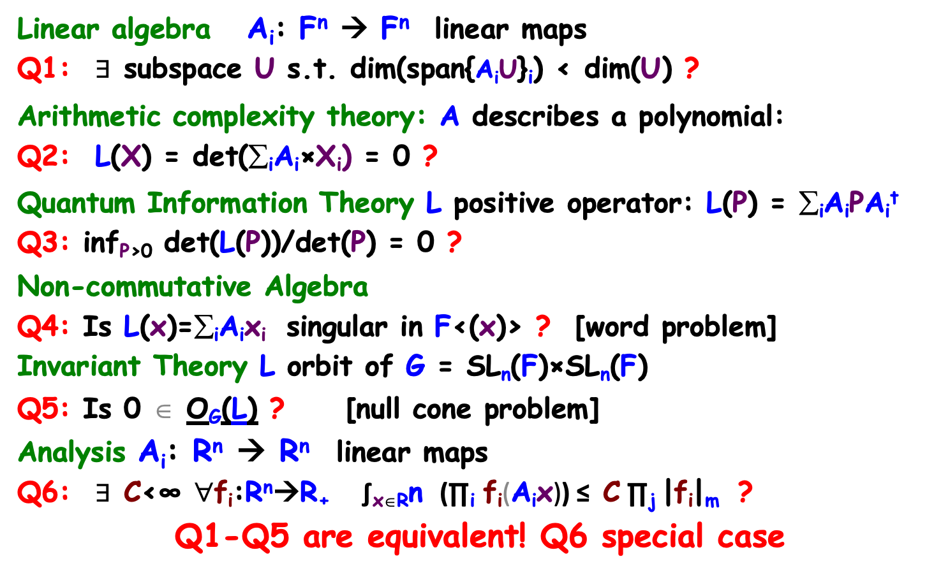
6 areas, 6 problems [GGOW’15+16]
L=(A₁,A₂,…,A_{m}), A_{i} ∈ Mat_{n}(F) (e.g. F=Q)
Linear algebra A_{i}: F^{n} → F^{n} linear maps
Q1: $∃$ subspace U s.t. dim(span{A_{i}U}_{i}) < dim(U) ?
Arithmetic complexity theory: A describes a polynomial:
Q2: L(X) = det(∑_{i}A_{i}×X_{i}) = 0 ?
Quantum Information Theory L positive operator: L(P) = ∑_{i}A_{i}PA_{i}^{t}
Q3: inf_{P>0} det(L(P))/det(P) = 0 ?
Non-commutative Algebra
Q4: Is L(x)=∑_{i}A_{i}x_{i} singular in F<(x)> ? [word problem]
Invariant Theory L orbit of G = SL_{n}(F)×SL_{n}(F)
Q5: Is 0 ∈ O_{G}(L) ? [null cone problem]
Analysis A_{i}: R^{n} → R^{n} linear maps
Q6: $∃$ C<∞ ∀f_{i}:R^{n}→R₊ ∫_{x∈R}n (∏_{i} f_{i}(A_{i}x)) ≤ C ∏_{j} |f_{i}|_{m} ?
Q1-Q5 are equivalent! Q6 special case
In P
In P
In P
In P
In P
In P
Notes:
Q6 is becomes equivalent under slight change.
AMAZING! We can use tools from so many areas solving problems in another

Slide 33





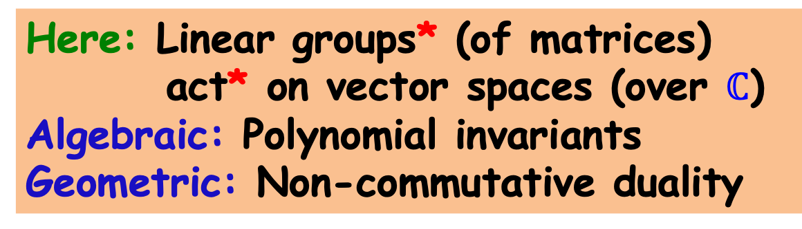
Invariant Theory symmetries, group actions, orbits, invariants
Here: Linear groups* (of matrices)
act* on vector spaces (over $ℂ$)
Algebraic: Polynomial invariants
Geometric: Non-commutative duality
R
- Energy
- Momentum
1
5
2
S₅
4
3
1
5
2
???
4
3
Area

Slide 34

Invariant theory
G acts on V=F^{k} , and so on F[v₁,v₂,…, v_{k}] (F=$ℂ$)
Orbit: Gv = {gv : g∈G}, Orbit closure: Gv
Invariant ring:
V^{G} = { p ∈ F[v] : p(gv) = p(v) for all g∈G }
Ex1: G=S_{n} acts on V=F^{n} by permuting coordinates
V^{G} = <elementary symmetric polynomials>
Ex2: G=SL_{n}(F)² acts on V=M_{n}(F) by v → RvC
V^{G} = < det(v) >
[Hilbert] Invariant rings are finitely generated!
Nullcone: N(G)= {v : p(v)=0 for all p∈V^{G} , deg(p)>0}
[Hilbert,Mumford] v∈N(G) ⬅➔ 0∈Gv ⬅➔ inf_{g∈G} |gv|=0
Analytic ⬅➔ Algebraic
Nullcone Membership:
Given v, does v∈N(G)?
Dual to Scaling problems!
Captures numerous problems across Math, CS, Physics, for different group actions
N(G)= {0}
Degree
bounds?
N(G)= {Singular matrices}
Key to alg
analysis
Algebraic Variety
Notes:
Derksen-Weyman, Domokos-Zubkov, Schofield-Van-der-berg

Slide 35
Unification and generalization I
[BGOWW’17,F’17,BFGOWW’18]
Notes:
Mainly elaborated on in Garg + Walter + Oliveira’s talks

Slide 36
Alternate minimization on groups
[BGOWW’17,F’17,BFGOWW’18]
Goal: Matrix Scaling Operator Scaling
A1=1, A^{t}1=1 ∑_{i}A_{i}A_{i}^{t}=I ∑_{i}A_{i}^{t}A_{i}=I
A₁
R
A
C
R
A₂
C
A_{m}
Alg: Alt. min. T_{n}xT_{n} Alg: Alt. min. GL_{n}xGL_{n}
(Diagonal group)² (General linear group)²
action on matrices action on tensors
Analysis: minimizing a potential function (permanent, capacity)

Slide 37
Alternate Minimization numerous other examples
(statistics, optimization, machine learning,…)
“solve” f(z₁,z₂,…,z_{i},…,z_{k}) all z_{i} complex
“solve” f(a₁,a₂,…,z_{i},…,a_{k}) one z_{i} simple/local
(a_{j} fixed)
Some examples we don’t understand well…

Slide 38
Alternate minimization on groups
Alt Minimization (coordinate descent)
(statistics, optimization, machine learning,…)
“solve” f(z₁,z₂,…,z_{i},…,z_{k}) all z_{i} complex
“solve” f(a₁,a₂,…,z_{i},…,a_{k}) one z_{i} simple/local
Here: group-theoretic framework
G = G₁×G₂×…….×G_{k} G_{i} = SL_{n}(C) or ST_{n}(C)
V = V₁ ⊗V₂⊗ …… ⊗V_{k} V_{i} = C^{n}, G_{i} acts on i-fibers of V
Goal: Given v∈V, scale it
[THM] Alt Min: |v’–”scaled”|<ε in poly(|v|,n,1/ε) steps.
k-tensor
Non-convex

Slide 39

Alternate Minimization over groups
Applications and analysis
Why does such a simple greedy algorithm converge?
What connects scaling and nullcone problems?
Non-product groups? (no alternate minimization)
G = G₁×G₂×…….×G_{k} G_{i} = SL_{n}(C) or ST_{n}(C)
V = V₁ ⊗V₂⊗ …… ⊗V_{k} V_{i} = C^{n}, G_{i} acts on i-fibers of V
Goal: Given v∈V, scale it, or else determine that v∈N(G)
k=2, Matrix Scaling, Operator Scaling
k=3, Kronecker coefficients (Representation Theory)
Any k, Entanglement distillation (Quantum Inf Theory)
Any k, Slice-rank of tensors (Combinatorics)
[THM] Alt Min: |v’–”scaled”|<ε in poly(|v|,n,1/ε) steps.
- |v_{i}| ≤ 1 (easy)
- |v_{i}| grows* by (1+1/n) (AMGM)
- v$∉$N(G) ➔|v|>exp(-n^{c}) (inv+rep th. ++)
k-tensor
Sometimes
not enough!
Same alg,
“same” analysis.
Potential: |.|₂

Slide 40
Unification & generalization II
Non-commutative duality,
Geodesic convexity,
Moment map
Notes:
Mainly elaborated on in Garg + Walter + Oliveira’s talks

Slide 41
Goal: Matrix Scaling Operator Scaling
A1=1, A^{t}1=1 ∑_{i}A_{i}A_{i}^{t}=I ∑_{i}A_{i}^{t}A_{i}=I
A₁
R
A
C
R
A₂
C
A_{m}
Alg: Alt. min. T_{n}xT_{n} Alg: Alt. min. GL_{n}xGL_{n}
(Diagonal group)² (General linear group)²
action on matrices action on tensors
Analysis: minimize a potential function (permanent, capacity, L₂)
Let’s switch analysis with goal!

Slide 42

Non-commutative duality
G acts on V (G matrix group, V vector space)
Goal: given v∈V compute f(v) = inf_{g∈G} |gv|₂
(find the lightest vector in the orbit of v)
How to certify f(v)>0? Invariant p(v)$≠$0!
[Kempf-Ness’79] f(v)>0 ⬅➔ µ(v*)=0, v*$≠$0
µ moment map: non-commutative gradient
Minimizing µ is a scaling problem, dual to
minimizing |.|₂ along orbits!
- Non-commut. generalization of LP duality
Geodesic convexity: local opt = global opt
Extends Euclidean convexity to Riemannian manifolds
Optimization
Non-convex
Intuitively explains the convergence of a local, greedy algorithm like
Alternate Minimization
Suggests extending convex optimization tools to geodesic setting
=0?
Nullcone
problem
v
Gv
v*
0
Notes:
This exponential convergence is sometimes called “linear convergence” in optimization literature.
This is the difference between “weak membership/separation” and “strong membership/separation” oracles.
Geodesically convex optimization is established (Nisheeth Vishnoi talk). But mostly, 1st order methods for which convergence is polynomial. Capacity is convex in the hyperbolic metric over PSD matrices, and we develop a 2nd order method that conv exp fast (Yuanzhi Li talk)

Slide 43
Geodesic convexity and algorithms
Beyond Euclidean convexity
New: Quantitative complexity analysis

Slide 44
Geodesic optimization [AGLOW’17, BFGOWW’19]
General groups, beyond alt min & convex opt
G acts on V. Given v∈V, 𝛆>0 , approximate the minimum of |u| or |µ_{G}(u)| in Gv.
Oracle access to action + function + derivatives.
First order method (’’gradient descent’’):
𝛆-convergence in O(poly(1/𝛆)) iterations
Second order method (’’box-constrained” Newton):
𝛆-convergence in O(polylog(1/𝛆)) iterations
O(.) depends on “smoothness” of the action
(geometry of the weights of irreps of the action)
Different problems
Simple parameters
Notes:
This exponential convergence is sometimes called “linear convergence” in optimization literature.
This is the difference between “weak membership/separation” and “strong membership/separation” oracles.
Geodesically convex optimization is established (Nisheeth Vishnoi talk). But mostly, 1st order methods for which convergence is polynomial. Capacity is convex in the hyperbolic metric over PSD matrices, and we develop a 2nd order method that conv exp fast (Yuanzhi Li talk)

Slide 45
Conclusions & Open Problems
General themes
- Algorithms & complexity interacts with Math
- Analytic solutions to algebraic problems
- Algebraic analysis of continuous algorithms
- Symmetry is prevalent, using it is powerful
Natural research directions
- Algs still exponential for some applications
- Power of geodesic algs for comb. optimization
- Nulcone problems abound. Nullcone ∈ P?
- C-SING ∈ P? “P vs. NP”? Any lower bounds??
[Makam-W’19] C-SING is not a nullcone problem!

Slide 46
Book ad
- Published by Princeton University Press
- Free (forever) on my website
- Comments welcome!

