Slide 1
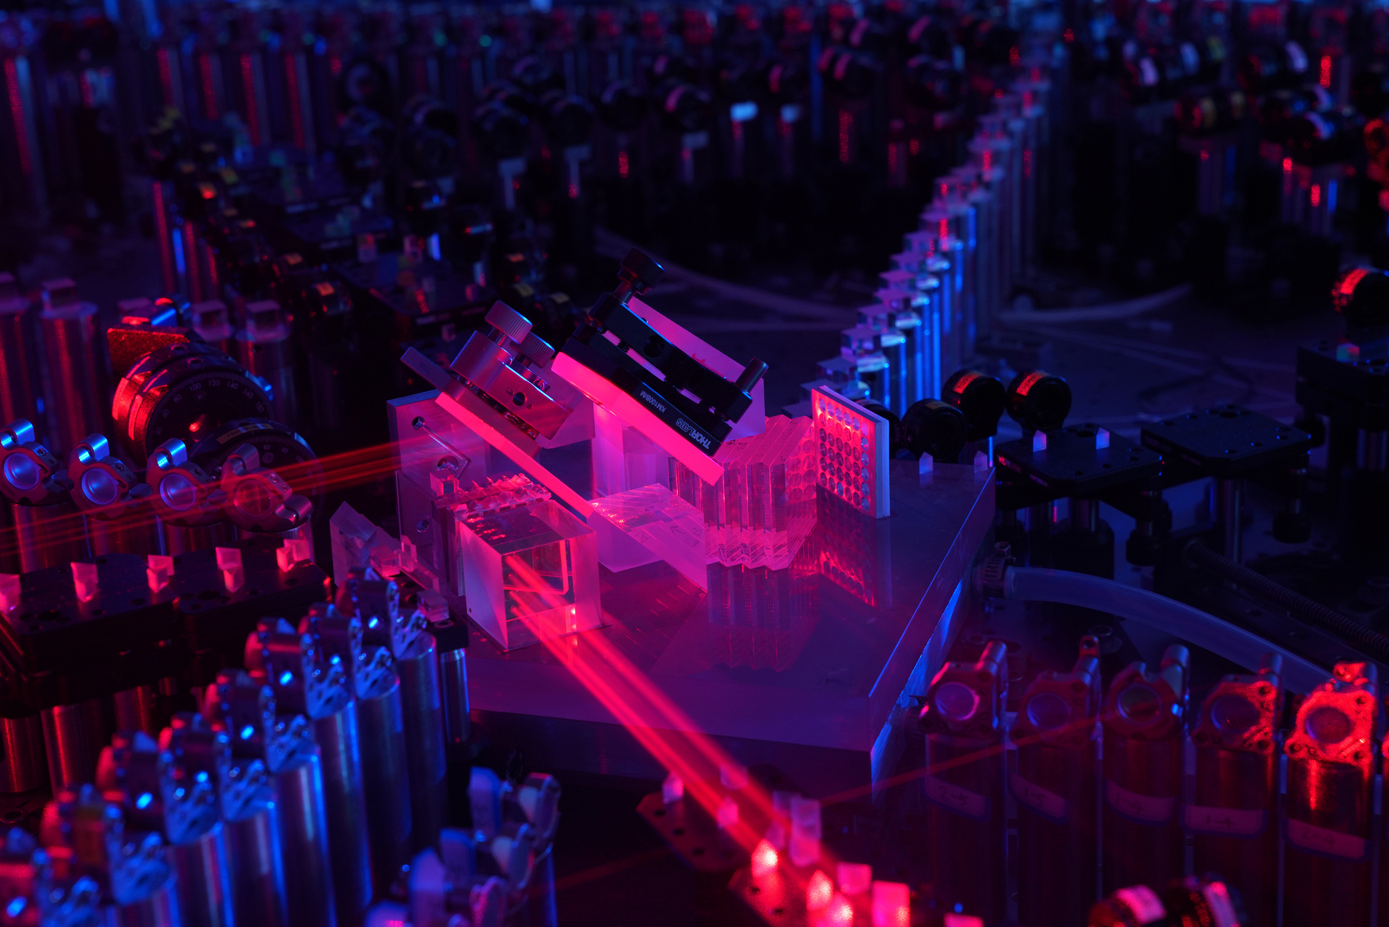
From multi-photon entanglement to quantum computational advantage
Jian-Wei Pan
CAS Center for Excellence in Quantum Information and Quantum Physics
University of Science and Technology of China

Slide 2
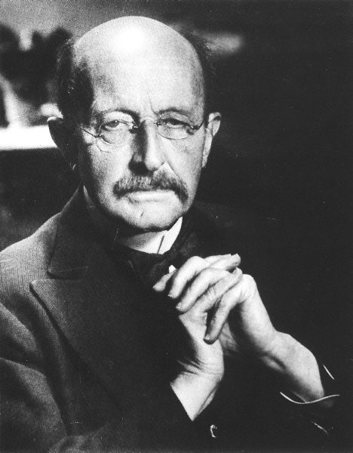
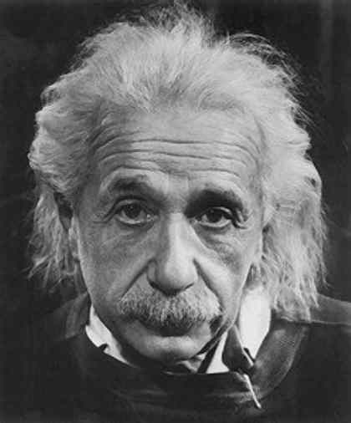
Two pillars of modern physics
Quantum mechanics
Theory of relativity

Slide 3
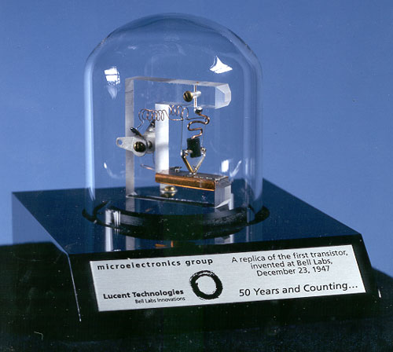
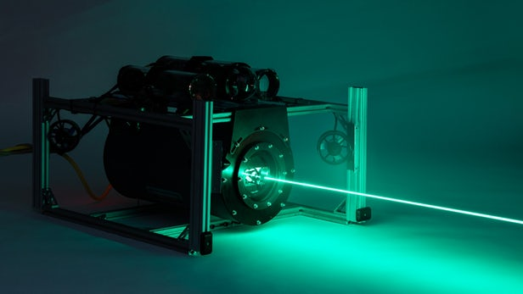
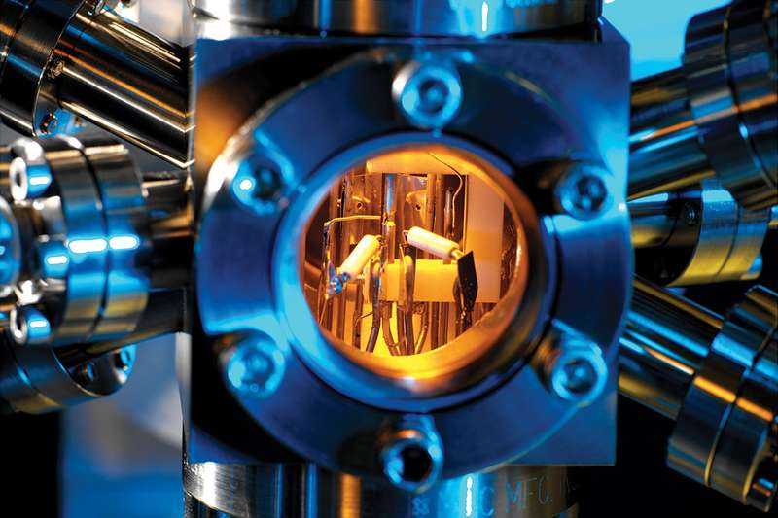
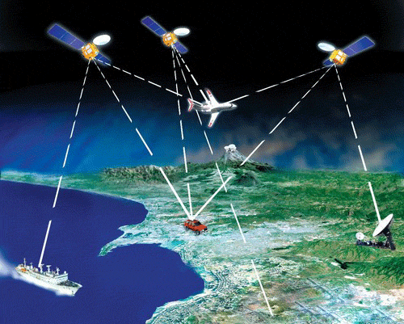


Quantum mechanics and information technologies
Transistors
Lasers
Atomic clocks
Electronic computer
Optical communication and internet
GPS

Slide 4
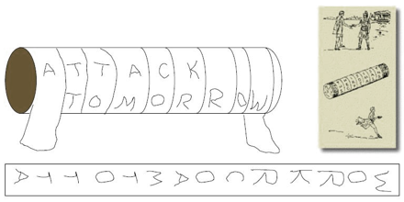
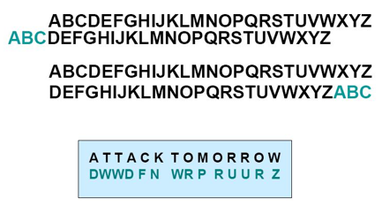
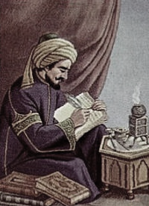
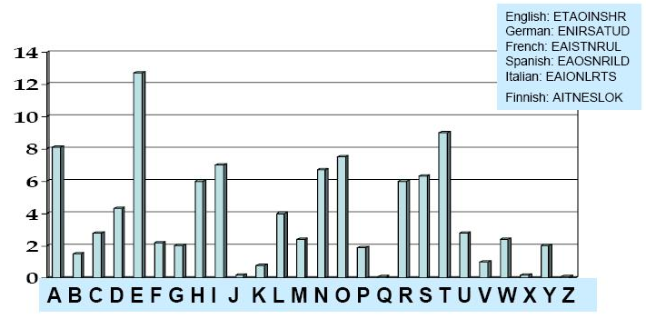
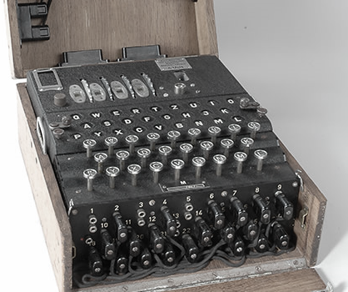
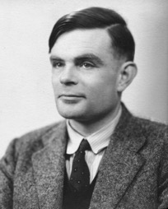
Challenges: information security
History: every advance in classical cryptography has been defeated by advances in cracking!
Ancient Greek scytale, 700 BC
Caesar cipher, 50 BC
Cracked via variations in the frequency of the occurrence of letters, by Al-Kindi (800-873)
RSA 512: cracked in 1999
RSA 768: cracked in 2009
RSA 1024: ?
SHA-1: cracked in 2017 by Google
……
Enigma machine broken by Alan Turing

Slide 5
Challenges: information security
All the classical encryption methods that depend on computational complexity, can be cracked in principle!
“……human ingenuity cannot concoct a cipher which human ingenuity cannot resolve”
—A few words on secret writing, Edgar Alan Poe (1841)

Slide 6
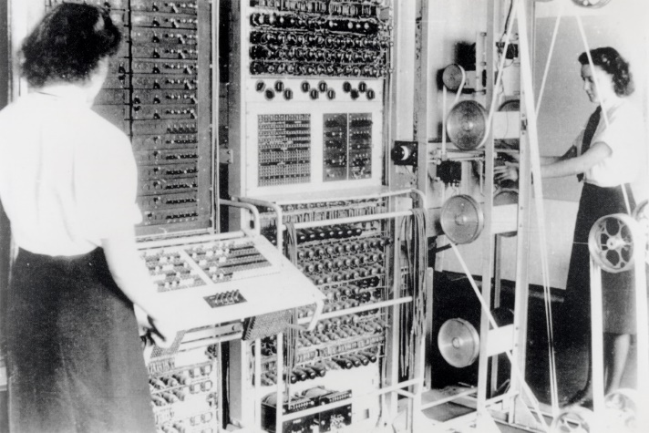
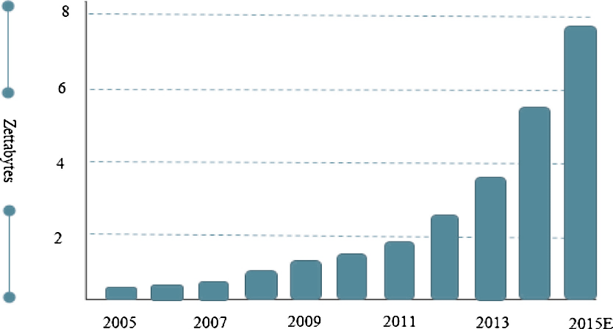
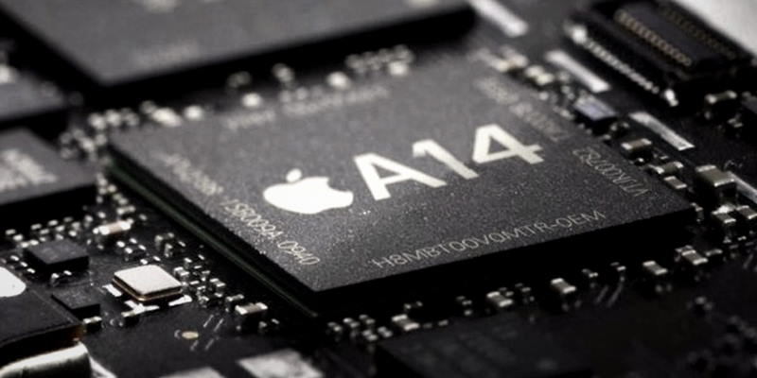
Challenges: computational capacity
In 1943: “I think there is a world market for maybe five computers”
--Thomas Watson, Chairman of IBM
Colossus, weight: 1 ton, power: 8.5kw, 5 kOPS (operations per second)
In 2010’s: Almost everyone owns computing power larger than the total computing power used in Apollo Program!
Apple A14, power: <5W, 11 trillion OPS
The world’s data volume roughly grow 40% per year

Slide 7
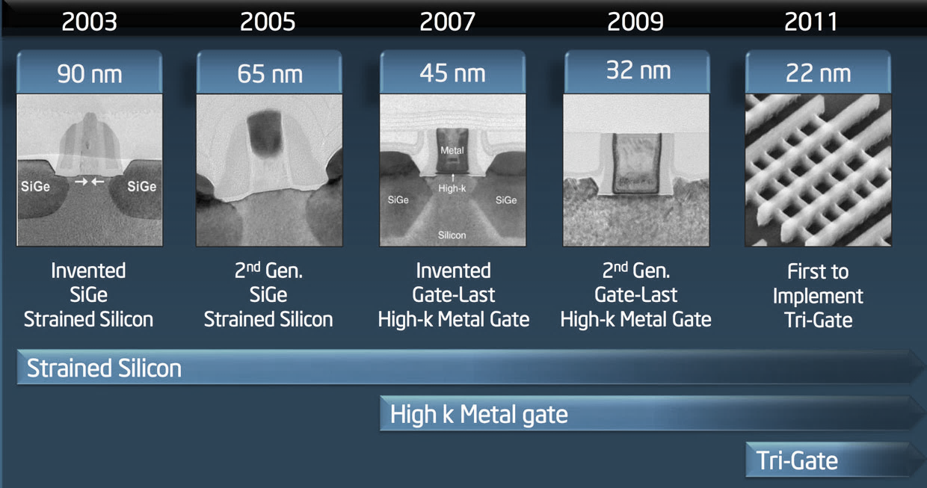
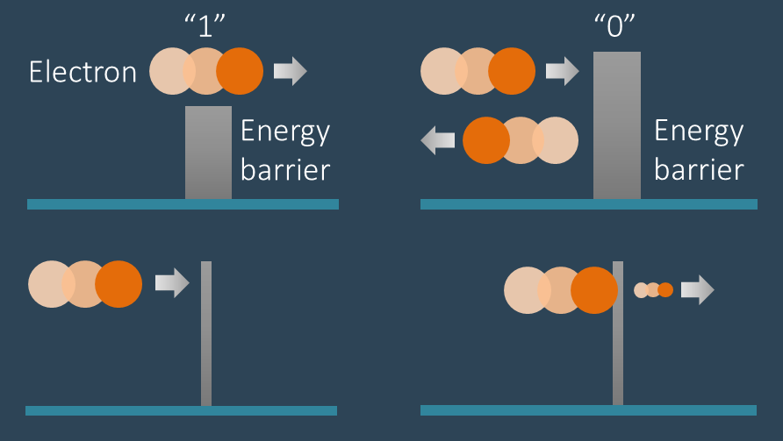
Challenges: computational capacity
Classical computational bottleneck
The world’s total computing power is insufficient to search a target in 2⁹⁰ database within a year
A technological limit
The Moore’s law that predicts the transistor density doubles every 18 months has come to an end
2017, 14 nm  2022, 4 nm  0.2 nm (atomic scale)  ???
Tunneling induced leakage 
The “0/1” logic in the transistors will fail

Slide 8

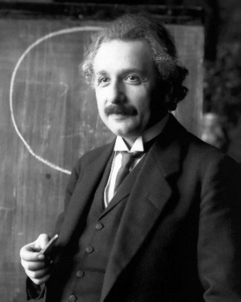
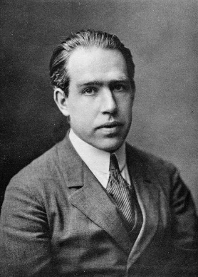
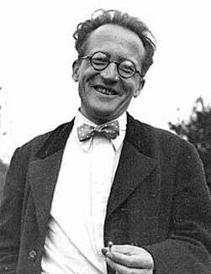
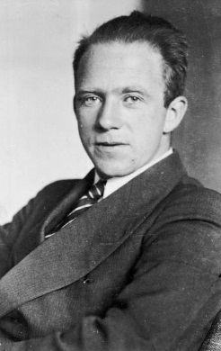
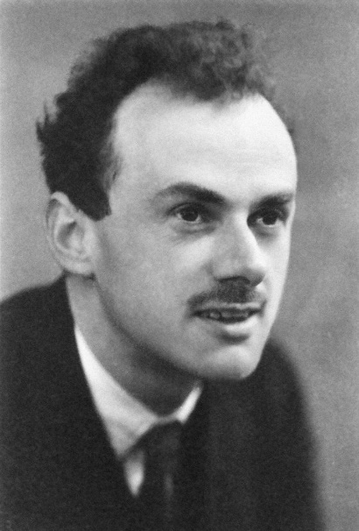
Quantum physics, after one century’s development, comes to the rescue for the problems confronted in the classical information technologies
Max Planck
Albert Einstein
Niels Bohr
Erwin Schrödinger
Werner Heisenberg
Paul Dirac

Slide 9
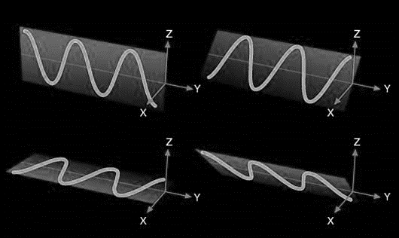
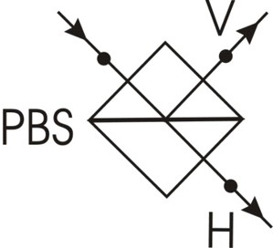

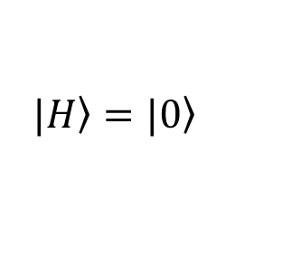



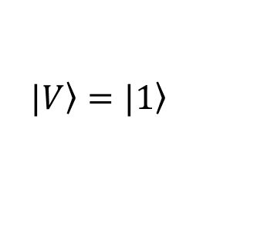
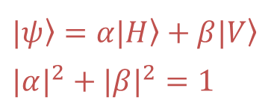
Quantum superposition and qubit
Classical Physics: “bit”
Quantum Physics: “qubit”
or
＋
0 or 1
$$|\left.0\right\rangle + |\left.1\right\rangle$$
A qubit encoded in the polarization of a photon
$|\left.H\right\rangle =|\left.0\right\rangle$
$|\left.V\right\rangle =|\left.1\right\rangle$
$$|ψ〉=α|H〉+β|V〉$$
$${|α|}^{2}+{|β|}^{2}=1$$
$$P={|β|}^{2}$$
Non-cloning theorem:
An unknown quantum state can not be copied precisely!
$${P=|α|}^{2}$$

Slide 10
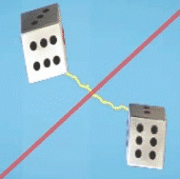
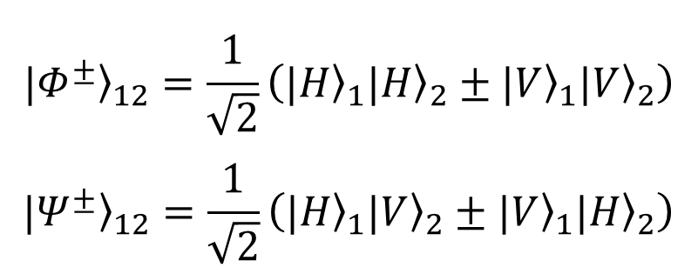
Quantum entanglement
Quantum entanglement:
＋
Bell states – maximally entangled states:
$${|Φ^{±}〉}_{12}=\frac{1}{\sqrt{2}}\left({|H〉}_{1}{|H〉}_{2}±{|V〉}_{1}{|V〉}_{2}\right)$$
$${|Ψ^{±}〉}_{12}=\frac{1}{\sqrt{2}}\left({|H〉}_{1}{|V〉}_{2}±{|V〉}_{1}{|H〉}_{2}\right)$$
Spooky action at a distance
—Albert Einstein

Slide 11
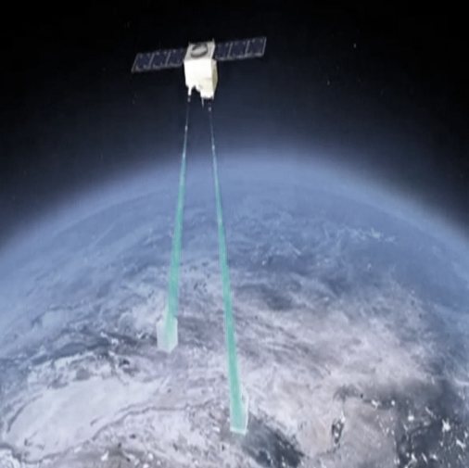
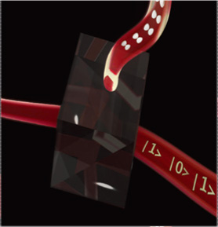
Quantum information processing (QIP)
Test of “spooky action at a distance”
Coherent manipulation of quantum systems
Quantum information processing
Unconditional security
Computational capacities
Quantum communication
Quantum computation and simulation

Slide 12
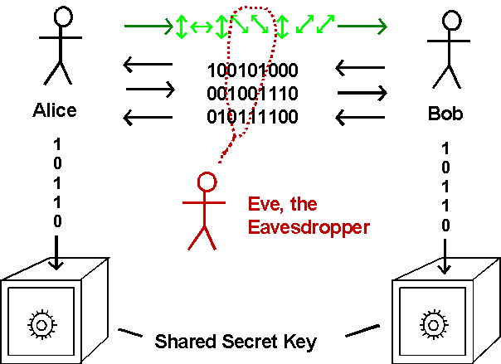
Quantum key distribution (QKD)
Single-photon-based key distribution: [Bennett & Brassard 1984 protocol]
Unconditional secure in principle
Any eavesdropping will be detected
 Secure key!
One-time pad encryption
 Unhackable!
Entanglement-based key distribution: [Ekert, PRL 67, 661 (1991)]

Slide 13
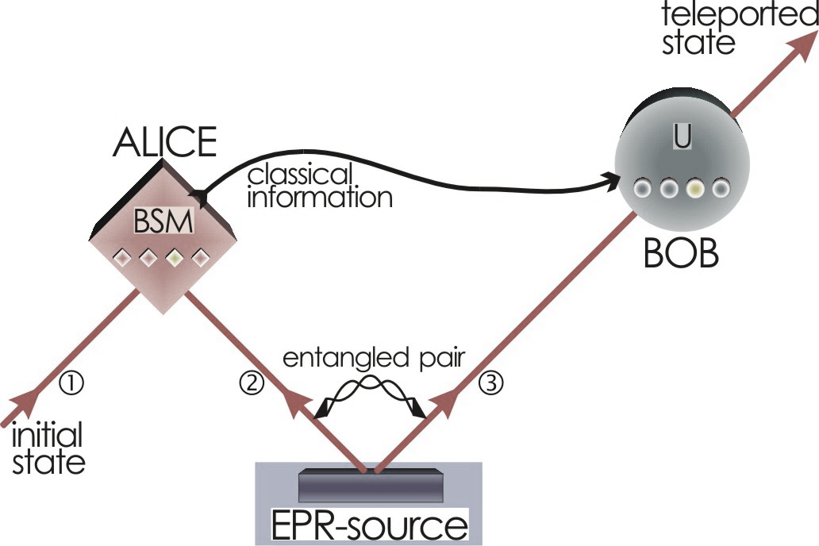
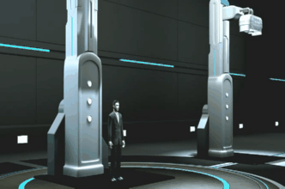
Quantum teleportation
Initial state
The shared entangled pair
Bennett et al., PRL 70, 1895 (1993)
Essential ingredient for quantum computation and distributed quantum network!
Star trek?

Slide 14
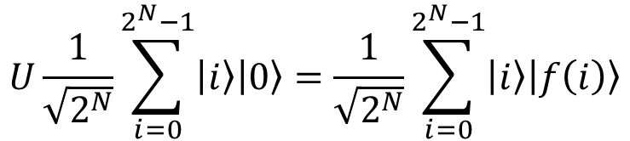
Quantum computation
Quantum Parallelism
Bits
0 or 1
00，01，10 or 11
000，001，010……
Qubits
0 + 1
00 + 01 + 10 + 11
000 + 001 + 010 + ……
V. S.
Evaluating a function f(x) for many different values of x simultaneously
$$U\frac{1}{\sqrt{2^{N}}}\sum_{i=0}^{2^{N}−1}{\left|\left.i\right\rangle \right.\left|\left.0\right\rangle \right.}=\frac{1}{\sqrt{2^{N}}}\sum_{i=0}^{2^{N}−1}{\left|\left.i\right\rangle \right.\left|\left.f\left(i\right)\right\rangle \right.}$$
Exponentially speedup!

Slide 15
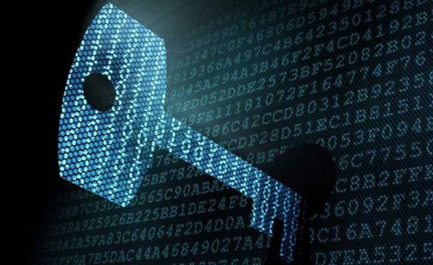
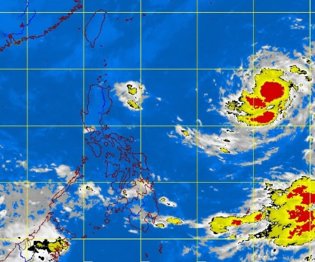

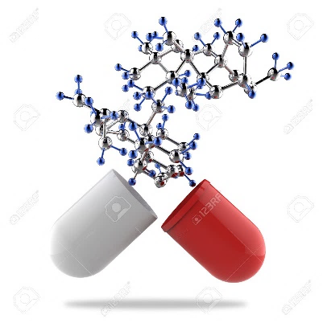
Quantum computation
Shor Algorithm (1994):
E.g. factor a 300-digit number with
Classical THz computer: 150,000 years
Quantum THz computer: 1 second!
Code-breaking can be done in minutes, not in millennia
Public key encryption, based on factoring, will be vulnerable!
Code-breaking
Weather forecast
Financial analysis
Drug design

Slide 16
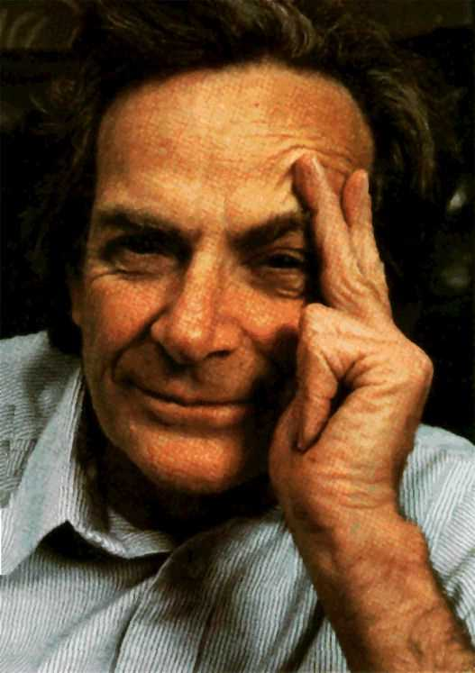
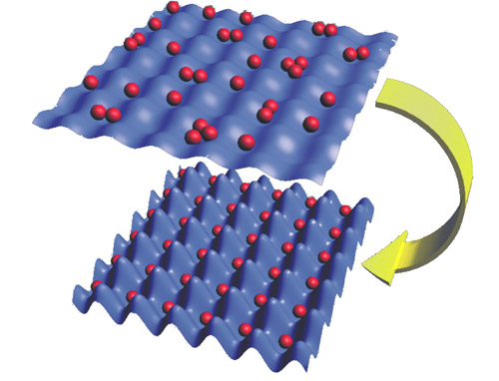
Quantum simulation
A quantum system of N two-level particles
Described by a 2^{N} (exponentially large) Hilbert space
Hardly accessible for classical computers to simulate its evolution
Natural solution: a quantum simulator
Consisting of superposition quantum states engineered to simulate the evolution of a quantum system
Richard Feynman
Mimicking condensed matter physics via cold atoms
High-temperature superconducting
(fractional) Quantum Hall effect
……

Slide 17
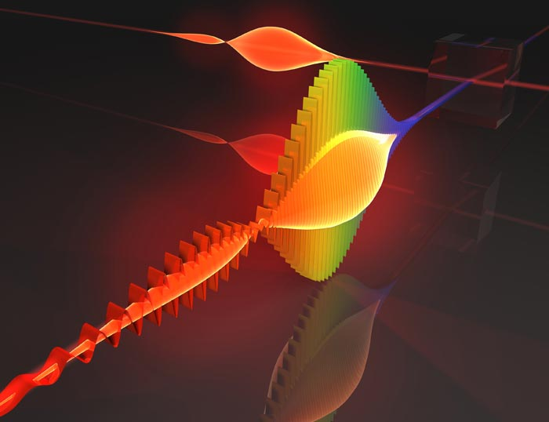

Optical quantum information processing
Why do we like photons?
Flying qubit (fastest quantum information transmitter)
Robust qubit (with weak interaction with environment)
High-precision manipulation with off-the-shell devices
Interconnections between distant physical systems

Slide 18
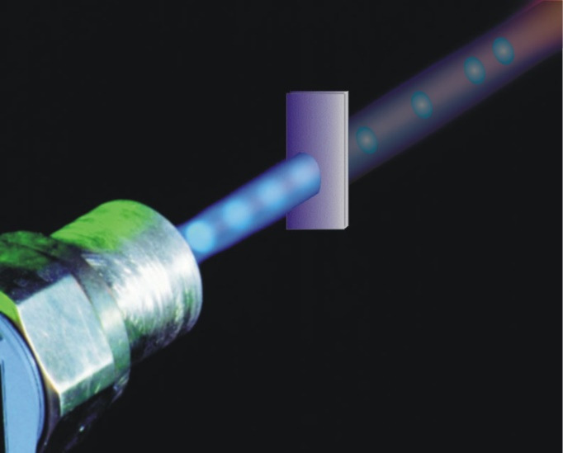
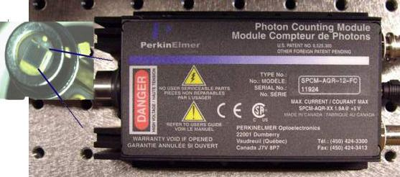
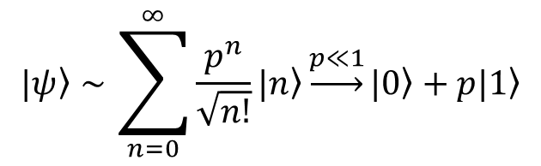
Elements of optical quantum information processing
Generation of single photons
Practical singe-photon source is far out of reach within current technologies
Probabilistic quasi single photon: weak coherence pulse
$$|ψ〉∼\sum_{n=0}^{∞}{\frac{p^{n}}{\sqrt{n!}}|n〉}\underset{→}{p≪1}|0〉+p|1〉$$
Single photon detector
InGaAs Avalanche photo diode
Si detector
Superconducting nanowire detector……

Slide 19
Elements of optical quantum information processing
Single-photon unitary operation
45°
half-wave plate
Arbitrary single-qubit unitary operation can be realized undergoing two types of wave plates
QWP: quarter-wave plate
HWP: half-wave plate

Slide 20
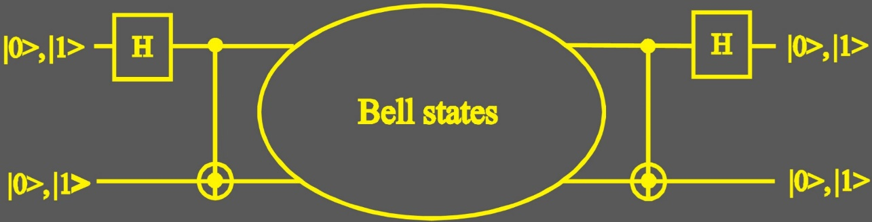
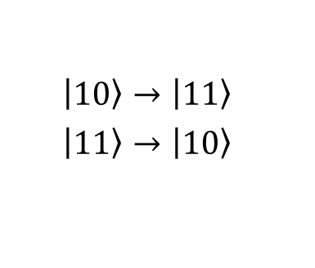
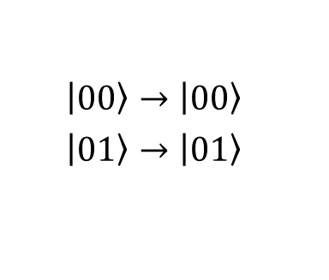
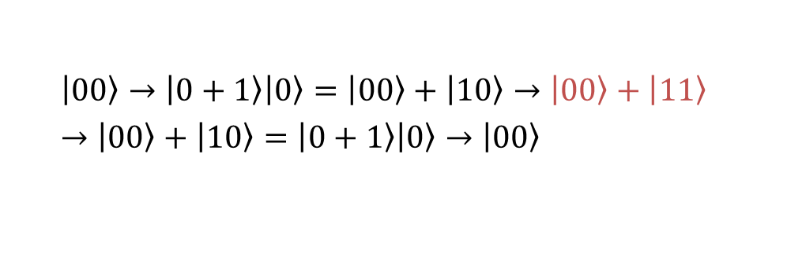
Elements of optical quantum information processing
Photon-photon logical gate
$$\left|\left.00\right\rangle \right.→\left|\left.00\right\rangle \right.$$
$$\left|\left.01\right\rangle \right.→\left|\left.01\right\rangle \right.$$
$$\left|\left.10\right\rangle \right.→\left|\left.11\right\rangle \right.$$
$$\left|\left.11\right\rangle \right.→\left|\left.10\right\rangle \right.$$
Bell states measurement
Manipulation of entanglement
$$\left|\left.00\right\rangle \right.→\left|\left.0+1\right\rangle \right.\left|\left.0\right\rangle \right.=\left|\left.00\right\rangle \right.+\left|\left.10\right\rangle \right.→\left|\left.00\right\rangle \right.+\left|\left.11\right\rangle \right.→\left|\left.00\right\rangle \right.+\left|\left.10\right\rangle \right.=\left|\left.0+1\right\rangle \right.\left|\left.0\right\rangle \right.→\left|\left.00\right\rangle \right.$$
For photons, CNOT gate requires strong non-linear coupling
But the coupling between photons is negligibly weak!
Generating Bell states

Slide 21
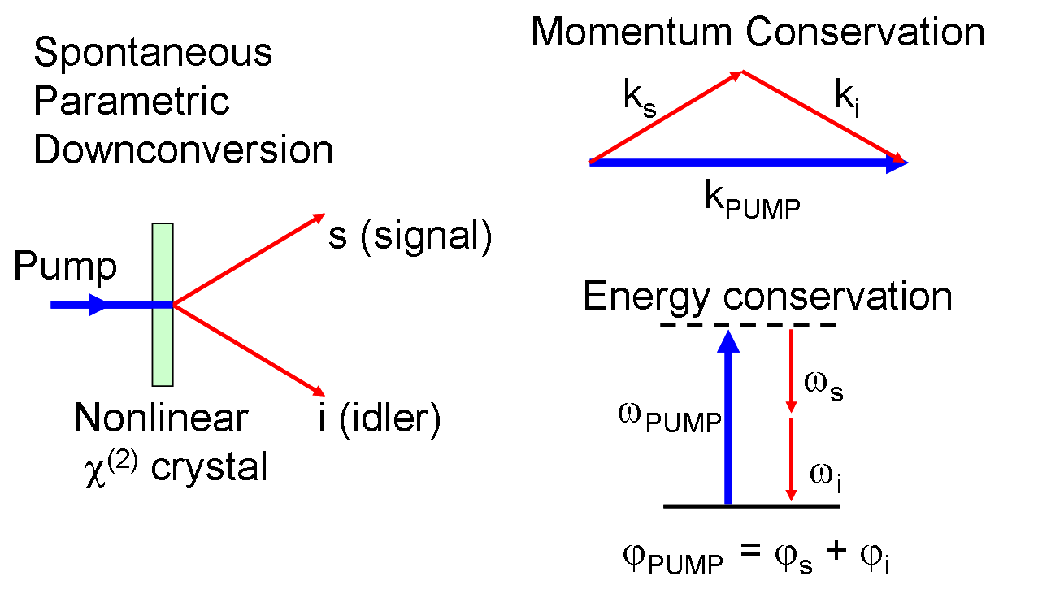



Elements of optical quantum information processing
Probabilistic generation of photonic entanglement:
Spontaneous parametric down-conversion (SPDC)
Squeezed vacuum state:
$$\sum_{k=0}^{∞}{g\left(k\right)e^{ikφ}{\left|\left.k\right\rangle \right.}_{1}{\left|\left.k\right\rangle \right.}_{2}}$$
Kwiat et al., PRL 75, 4337 (1995)

Slide 22

Post-selection induced non-linearity
To achieve non-linearity required by CNOT operation:
Making independent photons identical in all degrees of freedom  they are indistinguishable even in principle
Post-selection
H+V
The polarization states of two photons cannot be distinguished:
Entangled output state HH+VV
H+V
Input two-photon state: (H+V)(H+V)
Post-selecting one and only one photon in each of the two output event

Slide 23


Post-selection induced non-linearity
With the help of linear optics, the required non-linearity of CNOT gate can be effectively induced by post-selection
Bell-state measurement (BSM) required by quantum teleportation can be implemented with linear optics [Pan and Zeilinger, PRA 57, 2208 (1998)]

Slide 24



Secure QKD with realistic devices
QKD is the first practical QIP technology since only manipulation of single photon is needed
Decoy-state QKD: secure QKD with non-ideal single-photon sources
The distance of secure QKD exceeds 100km
Rosenberg et al., PRL 98, 010503 (2007)
Peng et al., PRL 98, 010505 (2007)
Measurement device independent (MDI) QKD: immune to any attack on detection
First experiment (50km):
Liu et al., PRL 111, 130502 (2013)
Extended distance (400km & 500km):
Yin et al., PRL 117, 190501 (2016)
Fang et al., Nat. Photon. 14, 422 (2020)
Making applications of QKD via fiber in metropolitan area feasible!

Slide 25



Toward long-disitance quantum communication
Quantum communication at a distance of 7600km was achieved with Micius satellite (launched in Aug, 2016)
Liao et al., Nature 549, 43 (2017)
Liao et al., PRL 120, 030501 (2018)
Urumqi
Vienna
Beijing

Slide 26



Large-scale quantum communication infrastructure
An integrated space-to-ground quantum communication network over 4,600 kilometres [Chen et al., Nature 589, 214 (2021)]
Micius satellite 
Beijing
Urumqi
~2600km
Jinan
National quantum communication backbone (~2000km) 
Hefei
Shanghai

Slide 27

Are photons sufficient for quantum computing?
Quantum computaiton: quantum circuit model
Single-qubit unitary gates
+
Two-qubit controlled-NOT gates
Universal quantum computation
Lloyd, PRL 75, 346 (1995)
With linear optics, nonlinearity required by CNOT gate can only be induced by post-selection
Is it sufficient for efficient quantum computation?

Slide 28

Efficient QIP with linear optics
Knill, Laflamme and Milburn (KLM), Nature 409, 46 (2001)
Non-deterministic quantum logic operations can be performed using linear optical elements
The success rate of the quantum logic can be arbitrarily close to one with the help of multi-photon state
Probabilistic photonic CNOT gate
O’Brien et al., Nature 426, 264 (2003)
Gasparoni et al., PRL 93, 020504 (2004)
Zhao et al., PRL 94, 030501 (2005)

Slide 29



One-way quantum computation model
Universal QC resource: multi-particle entanglement
cluster state ${\text{|}\left.Φ\right\rangle }_{C}$:
Quantum gates are implemented by measuring particles in a certain order and in a certain basis
Raussendorf and Briegel, PRL 86, 5188 (2001)

Slide 30




Four-photon entanglement
In 2001, brightness of entanglement source: 2500pair/s@76MHZ (P~310⁻⁵)
(HH+VV)(HH+VV)
= HHHH+HHVV+VVHH+VVVV
→ HHHH+VVVV
Pan et al., PRL 86, 4435 (2001)

Slide 31



Six-photon cluster states
In 2007, by developing a brighter laser pump source, Verdi 10W → 16W, IR ~ 2.5W
brightness of entanglement source: 93000pair/s@76MHz(P~10⁻³)
H gate
Lu et al., Nature Physics 3, 91 (2007)

Slide 32

Multi-photon interferometry
Essential task: generation and manipulation of multi-photon entanglement
P
P
P
P
Two-photon entanglement source: P →Four-photon entanglement: P²/2
→ Six-photon entanglement: P³/4 → Eight-photon entanglement: P⁴/8…
High-brightness entanglement source is needed!

Slide 33


The request for both high brightness & fidelity
With higher pump
Increase probability
More double pair emissions  degrades fidelity
$$P_{n}=\frac{μ^{n}e^{−μ}}{n!}$$
error
Can we further push the brightness of two-photon entanglement, meanwhile with high fidelity?

Slide 34


Disentangles the timing from the polarization
Different spectral widths, decrease the indistinguishability thus the fidelity
Narrow-band filters (~3nm), causes unnecessary waste of photons
6nm
12nm
Interferometric Bell-state synthesizer, disentangles the timing from the polarization
~1 million coincidence counts per second without filter, with ~90% fidelity (P~10⁻²)
Eight-photon entanglement [Yao et al., Nature Photonics 6, 225 (2012)]

Slide 35




SPDC: driven to perfection
Collect all photons from two separate circular beams (P~510⁻²)
V. S.
Ten-photon entanglement
[Wang et al., PRL 117, 210502 (2016)]
Frequency uncorrelated, no narrowband filtering loss (P~710⁻²)
V. S.
12-photon entanglement
[Zhong et al., PRL 121, 250505 (2018)]

Slide 36




Demonstrations of quantum algorithms
Gover’s searching algorithm
Chen et al., PRL 99, 120503 (2007)
Shor’s factoring algorithm (15 = ? X ?)
Lu et al., PRL 99, 250504 (2007)
Solving linear systems of equations
Cai et al., PRL 110, 230501 (2013)
Classical: O (N) steps
Quantum: O (log(N)) steps
Quantum machine learning
Cai et al., PRL 114, 110504 (2015)

Slide 37



Quantum error correction
Inevitable noise  qubit error during quantum computation
Bit flip error: $α\left|\left.0\right\rangle \right.+β\left|\left.1\right\rangle \right.→α\left|\left.1\right\rangle \right.+β\left|\left.0\right\rangle \right.$
Phase flip error: $α\left|\left.0\right\rangle \right.+β\left|\left.1\right\rangle \right.→α\left|\left.0\right\rangle \right.−β\left|\left.1\right\rangle \right.$
Mixed error: $α\left|\left.0\right\rangle \right.+β\left|\left.1\right\rangle \right.→α\left|\left.1\right\rangle \right.−β\left|\left.0\right\rangle \right.$
Error-correction code：
Similar to redundant coding in classical computing
$\left|\left.0\right\rangle \right.→\left|\left.000\right\rangle \right.$, $\left|\left.1\right\rangle \right.→\left|\left.111\right\rangle \right.$
Superposition:
$$α\left|\left.0\right\rangle \right.+β\left|\left.1\right\rangle \right.→α\left|\left.000\right\rangle \right.+β\left|\left.111\right\rangle \right.$$
Some quantum error-correction code schemes:
Shor, PRA 52, R2493 (1995) 9 qubits
Steane, PRL 77, 793 (1996) 7 qubits
Laflamme et al., PRL 77, 198 (1996) 5 qubits
Challenge: require error rate of single qubit < 2×10⁻⁵ !

Slide 38



Topological quantum error correction
Protect quantum bits/gates at the physical level
Kitaev, Ann. Phys. 303, 2 (2003); Ann. Phys. 321, 2 (2006)
Raussendorf et al., Ann. Phys. 321, 2242 (2003)
Nayak et al., RMP 80, 1083 (2008)
 Relax the error threshold rate from 10⁻⁵ to 10⁻²
Excited states
Protect qubits with energy gap
Quantum gates: Braiding Anyons
$∆E$ Energy Gap
$$\left.|ψ\right\rangle$$
Ground states

Slide 39


Topological quantum error correction
Revealing fractional statistics of Anyons with 6-photon entanglement
Lu et al., PRL 102, 030502 (2009)
Demonstration of simplest example of topological quantum error correction with 8-photon entanglement
Yao et al., Nature 482, 489 (2012)

Slide 40


There are huge technical challenges in scalable quantum computing
So far one has only verified the possibility of quantum computing……
Shor’s factoring algorithm (15 = ?  ?)
How to show quantum computational advantage?

Slide 41

Roadmap of quantum computing
Error correction threshold
Universal QC
Milestone 1: Beating classical supercomputer in specific tasks (quantum computational advantage)
Quantum computational advantage
Near-term applications
Classically simulatable
Milestone 2: Quantum simulation to reveal the microscopic mechanism of condensed matter physics (e. g., high temperature superconductivity, etc.)
Milestone 3: Universal and programmable quantum computers

Slide 42


Boson sampling
Boson sampling [Aaronson and Arkhipov, Theory of Computing. 9, 143 (2013)]
Left or right
$$\left|\left.left\right\rangle \right.+e^{iφ}\left|\left.right\right\rangle \right.$$
？
Single-photon interference
Two-photon
interference
Classical Galton Board

Slide 43





How to classically predict the outcome of boson sampler?
m input single photons into an N-mode interferometer (N>m)
Calculation:
Permanent of m$×$m matrix U
S_{m} is the set of all permutation of m elements
e.g.,
$Per\left(\begin{matrix}a & b \\ c & d\end{matrix}\right)$ = ad + bc
$Per\left(\begin{matrix}a & b & c \\ d & e & f \\ g & h & i\end{matrix}\right)$ =aei + bfg + cdh + ceg + bdi + afh

Slide 44


Bosons VS Fermions
Bosons commute:
Fermions anti-commute
Hard Easy

Slide 45


Demonstrating quantum computational advantage
Classical algorithm needs O(m²2^{m+1}) steps, sharp P-complete problem!
With ~50 input single photons, the complexity will challenge fastest supercomputer today!
[Nat. Phys. 13, 1153 (2017)]
Fugaku (supercomputer No. 1)
Interference
circuit
Quantum computer: directly detect the distribution of output photons
Coherent manipulation of ~50 photons to archive quantum computational advantage!

Slide 46

Challenges for large-scale Boson sampling
High efficiency, high indistinguishability
Multi-mode interferometer with high transmission rate and random matrix—phase stable, Harr-random matrix, very large mode volume
High-efficiency and fast single-photon detection
Validation of the obtained samples
Unlike Shor’s algorithm where its solution can be efficiently verified
For Boson sampling a full certification of the outcome is strongly conjectured to be intractable for classical computation

Slide 47


How to increase the number of manipulated photons?
To increase number of entangled photons is extremely hard due to probabilistic source
In 2013:
Counts ~600,000/s
Indistinguishability ~90%
Source efficiency ~0.8%
Circuit efficiency: 10%-30%
Detection efficiency: best 90%
50-photon rate ~10⁻¹⁵⁰ Hz
Possible solution: manipulation of multi deterministic single photons emitted from quantum dots!

Slide 48
Check list for a perfect single-photon source
High efficiency
  Quantum efficiency: the decay of excited states should predominantly result in an emitted photon
  Deterministic generation: upon a pulsed excitation, the source should deterministically emit one photon in a push-button fashion
  High collection efficiency: the radiated photons should be extracted with a high efficiency to a single spatial mode
2. High purity—the emission should have a vanishing multi-photon probability, G²(0)=0
3. High indistinguishability—individual photons emitted at different trials should be quantum mechanically identical in all degree of freedom (time, frequency etc.)

Slide 49


Resonant excitation of a single quantum dot
Pulsed resonance fluorescence
99.5% indistinguishability
Coherent drive, no time jitter
Quantum dots:
InGaAs embedded in GaAs
Deterministic drive
He et al., Nature Nanotechnology 8, 213 (2013)

Slide 50




Efficient single photons quantum dot-microcavity
Coherent drive + Purcell enhancement
Both high extraction efficiency and indistinguishability
1 μm
Ding et al., PRL 116, 020401 (2016)
Wang et al., Nature Photonics 13, 770 (2019)

Slide 51



Prototype quantum computer for Boson sampling
single-photon switch
Fugaku
(supercomputer No. 1)
low-loss multi-photon interferometer
high-efficient single-photon source
5-photon Boson sampling machine
Wang et al., Nature Photonics 11, 365 (2017)
Provably faster than ENIAC and TRADIC for the first time
Fugaku
(supercomputer No. 1)
Quantum computational advantage!

Slide 52



Prototype quantum computer for Boson sampling
Boson sampling with 20 single photon input 60 modes [PRL 123, 250503 (2019)]
With output state space dimension of 2⁴⁸, approaching to quantum computational advantage regime

Slide 53

Prototype quantum computer for Boson sampling
Now single-photon rate ~30 million/s
Improvement to >40 million/s in progress
Will support boson sampling with ~30 photons, with will outperform the best laptop by 10,000 times, but still cannot beat a supercomputer
Single quantum dot in a tunable open cavity

Slide 54






Gaussian Boson sampling (GBS)
Input N single photons
Boson sampling:
U
Input N squeezed vacuum states
Gaussian Boson sampling:
(with same order of classical computational complexity)
U
Hamilton et al., PRL 119, 170501 (2017)
Quesada et al., PRA 98, 062322 (2018)
GBS makes full use of SPDC!

Slide 55



Quantum light sources for GBS
Two mode squeezed state (TMSS) with high squeezing parameters (mean photon number per pulse ~5)
25 TMSS equivalent to 50 single mode squeezed state (SMSS)
High purities and efficiencies

Slide 56

Large-scale interferometer
Size 100100 Haar-random matrix,
fully connected (arbitrary input can goes to arbitrary output),
phase stable, wave-packet overlap >99.5%, transmission rate >98%

Slide 57

Phase locking of the whole optical setup
50 independent paths, each with 2m free space +20m optical fiber
Locking precision: 25nm

Slide 58

High-efficiency single photon detectors
Superconducting nanowire single-photon detector (SNSPD) with efficiency >80%

Slide 59


System calibration

Slide 60

Validation and benchmarking
How to validate GBS?
Gathering circumstantial evidence while ruling out possible hypotheses plausibly to occur:
Thermal states—would result from excessive photon loss
Distinguishable—would be caused by mode mismatch
Photon number distributions and two-photon correlation statistics deviate from thermal state and distinguishable hypothesis

Slide 61

Validation and benchmarking
Validation against thermal state hypothesis with detected photon number 34 to 38
Validation against uniform distribution
(classical computing results were calculated by supercomputer Taihu-light)

Slide 62


Quantum computational advantage using photons
“Jiuzhang（九章）”：Gaussian Boson sampling with up to 76 photons
[Science 370, 1460 (2020)]
Sampling rate about 10¹⁴ times faster than classical supercomputer with currently known optimal algorithm [PRA 98, 062322 (2018)]

Slide 63


Google’s quantum computational advantage
Random circuit sampling
Google’s quantum processor “Sycamore” with 53 superconducting qubits
Arute et al., Nature 574, 505 (2019)
Aaronson & Chen, In 32nd Computational Complexity Conf. (2018)
Classical computer: cost a few days to compute all the 2⁵³ probability amplitudes
Sycamore: generated a million (2²⁰) noisy samples in 200 seconds
But what about 2³⁰ samples? 2⁴⁰ samples?

Slide 64
Comparison with Google’s “Sycamore”
Random circuit sampling in Sycamore
Gaussian Boson sampling in Jiuzhang
Sample size | quantum | Classical super-
1 million | 200 s | 2 days
10 billion | 20 days | 2 days
Sample size | quantum | Classical super-
50 million | 200 s | 0.6 billion years
10 billion | 10 hours | 120 billion years
The computational advantage would be reversed with larger size of samples!
The computational advantage does not rely on the size of samples!
→ Sample-size-dependent loophole
→ Closed the sample-size-dependent loophole!
Sycamore’s state-space: 10¹⁶
Operating temperature: -273.12℃ (30mK)
Jiuzhang’s state-space: 10³⁰
Room temperature

Slide 65




Recent progress: GBS with 108 detected photons
Stimulated PDC: same laser power, 4 times brighter squeezed light
Next steps:
Tunable interferometer
More compact set-up
Seek applications…
144-mode interferometer

Slide 66



Potentially practical applications
Now Jiuzhang can only solve GBS problem
But GBS links to potentially practical applications:
Graph-related problems: optimization, graph similarity, point process
[PRL 121, 030503 (2018), PRA 98, 012322 (2018), PRA 98, 032310 (2018), PRA 101, 032314 (2020)]
Quantum chemistry: simulation of molecular vibration spectrum and molecular docking
[Nat. Photon. 9, 615 (2015), Sci. Adv. 6, eaax1950 (2020)]
Quantum machine learning [PRA 102, 012417 (2020)]
……

Slide 67


Other candidates of quantum computing
Superconducting quantum circuit
Ultra-cold atoms in optical lattices
Scalability and high-precision quantum manipulation

Slide 68



Superconductor quantum computing
Entanglement of 10 and 12 superconducting qubits
[PRL 119, 180511 (2017); PRL 122, 110501 (2019)]
Demonstration of topological robustness of Anyonic braiding statistics [PRL 121, 030502 (2018)]
Strongly correlated quantum walks with 12-qubit superconducting processor
[Science 364, 753 (2019)]
Fabrication and measurement of 66-qubit device for random circuit sampling in progress

Slide 69


Quantum computation and simulation with ultracold atoms
Ultracold atoms is a novel system for quantum simulation
“Quantum engineering” of Hamiltonians
Atom-atom entanglement in optical lattices
~600 pairs: Nature Physics 12, 783 (2016)
Demonstration of Toric-code Hamiltonian and the Anyonic fractional statistics
Nature Physics 13, 1195 (2017)

Slide 70


Quantum computation and simulation with ultracold atoms
Staggered-immersion cooling defect-free optical lattice
Simulating a LGT theory with a 71-site quantum simulator
Filling factor: 99.2%
~1200 pairs of atom-atom entanglement with high fidelity (99.3%)
Science 369, 550 (2020)
Schwinger equation is simulated
Guass’s law is verified in the experiment
Nature 587, 392 (2020)

Slide 71


Quantum computation and simulation with ultracold atoms
Quantum simulation of Gauge potential with neutral atoms
Phase diagram of 1D spin-orbit coupling [PRL 109, 115301 (2012)]
Realization of 2D SOC [Science 354, 83 (2016)]
Quantum simulation with ultracold molecules
Obtaining information of potential energy of triatomic molecule containing 49 electrons (cannot be obtained by solving multi-electron Schrödinger equation with classical numerical simulation) [Science 363, 261 (2019)]
Coherent manipulation of an entangled state of ~100 atoms
Mimicking strongly correlated topological matter, phase diagram of Fermi-Hubbard model, dynamics of ultracold chemistry……
Next step:

Slide 72
Future prospects
Error correction threshold
Universal QC
Quantum computational advantage
Near-term applications
Classically simulatable
In next 5-10 years: coherent manipulation of a few hundreds to thousands qubits  study the mechanism of high-temperature superconducting, quantum hall effect and so on
In next 15-20 years: quantum computer with millions of qubits  realize universal and programmable quantum computers with the help of quantum error correction

Slide 73




Future prospects
Nature has two outstanding achievements
Match nature!
Quantum laws
Human’s intelligence
Match
human brains!
Quantum computing
Artificial intelligence
To understand or to create new intelligence, maybe we can go beyond Nature!

Slide 74
Thanks for your attention!

